Slide 1


Predicting Flight Ticket Prices Using Machine Learning

Slide 2

OVERVIEW
Abstract
Objective
Introduction
Existing System
Proposed System
Predictive Modelling Techniques
Model Building
System Architecture
Data Flow Diagrams
Screenshots
Conclusion
Future Enhancements

Slide 3
OBJECTIVE
To get the effective price for the customers.
Make UI user friendly.
Use of various ML models to know more about the dataset and get accurate results.
To study flight prices ups and downs according to routes and on different days.

Slide 4

INTRODUCTION
The flight ticket buying system is to purchase a ticket many days prior to flight take-off so as to stay away from the effect of the most extreme charge.
Mostly, aviation routes don’t agree this procedure.
Plane organizations may diminish the cost at the time, they need to build the market at the time when the tickets are less accessible, they may maximize the costs.
So, the cost may rely upon different factors. To foresee the costs this venture uses AI to exhibit the ways of flight tickets after some time.
All organizations have the privilege and opportunity to change its ticket costs at any time.

Slide 5
EXISTING SYSTEM
Nowadays, the airline corporations are using complex strategies and methods to assign airfare prices in a dynamic fashion.
These strategies are taking into account several financial, marketing, commercial and social factors closely connected with the final airfare prices.
Due to the high complexity of the pricing models applied by the airlines, it is very difficult for a customer to purchase an air ticket in the lowest price, since the price changes dynamically.
One of the reasons that ML has attracted scientists from several disciplines is its ability to provide human-like intelligence to machines as the amount of data used during learning increases.
EXISTING SYSTEM DISADVANTAGES:-
Data Acquisition.
Time and Space

Slide 6
PROPOSED SYSTEM
We are proposing several techniques which are able to provide the right time for the buyer to purchase an air ticket by predicting the airfare price, that have been proposed recently.
In prediction model, once data has been collected, the analyst selects and trains statistical models, using historical data.
Although it may be tempting to think that big data makes predictive models more accurate, statistical theorems show that, after a certain point, feeding more data into a predictive analytics model does not improve accuracy.
PROPOSED SYSTEM ADVANTAGES:-
Fleet maintenance.
Identifying financial risks and modeling credit.

Slide 7
Introduction to predictive modelling techniques used in project
Linear Regression
Linear regression is a statistical method used to model the relationship between a dependent variable and one or more independent variables by fitting a linear equation to the observed data.
2. Bagging Regression
Bagging regression is an ensemble technique that combines predictions from multiple regression models trained on random subsets of the training data to improve prediction accuracy and reduce variance.
3. Regression SVM(Polynomial and Linear)
Regression SVM (Support Vector Machine) is a supervised learning algorithm that uses support vectors to find the optimal hyperplane for regression tasks, aiming to minimize prediction errors.
4. Multilayer perceptron
A multilayer perceptron (MLP) is a type of feedforward artificial neural network with one or more hidden layers, used for supervised learning tasks.

Slide 8
Dataset Overview
We have used flight-fare dataset from Kaggle.com
There are 1681 rows and 11 columns
Features:
Date of journey
Airline
Departure Time
Arrival Time
Source
Destination
Route
Duration
Total Stops
Price
Additional Info

Slide 9
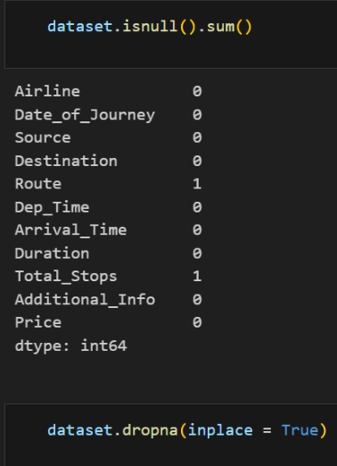
Data Pre-processing
To ensure data quality, we pre-processed the collected data by handling null values.
We got only 2 null values in the dataset.
We have dropped them using dropna().

Slide 10
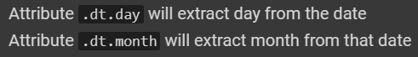
Handling object data
Date_of_journey, departure time , arrival time and duration are object datatype.
Using pandas methods to convert object datatype to datetime datatype.

Slide 11
Handling categorical data
Airline , source, destination, route , total stops and additional info are categorical data in our case.
Nominal data
Data is not in order - OneHotEncoder
Ordinal data
Data is in order - LabelEncounter

Slide 12
Feature Selction
Finding out the best feature which will contribute and have good relation with the Target variable.
feature_importances using Extra tree regressor
Variance inflation factor(VIF) for multicollinearity

Slide 13
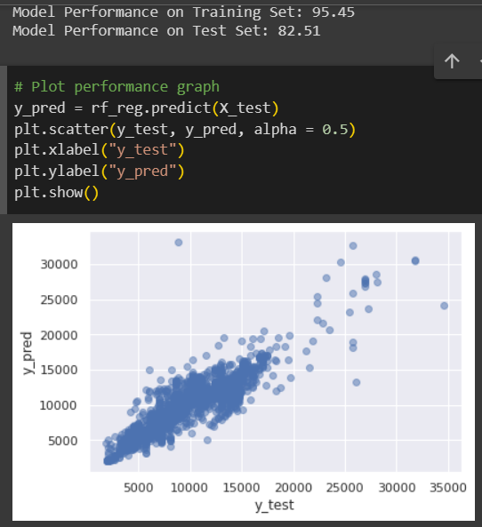
The best fit- Random Forest
Split the data into train and test data
Scaling is not required.
Train model
Gauge model
In regression, check the RSME score.

Slide 14
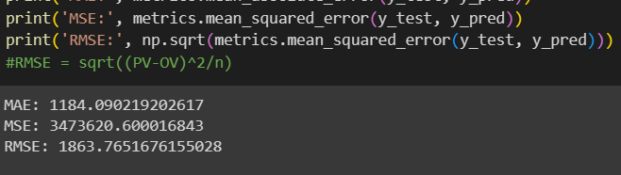
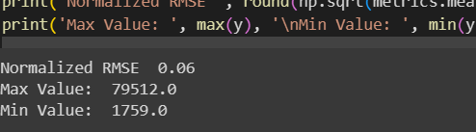
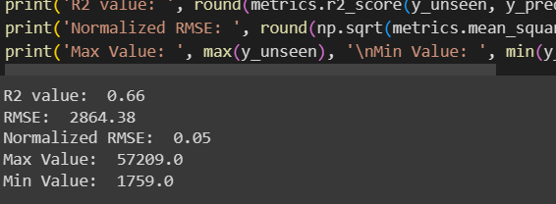
RMSE
For trained dataset
For test dataset
Normalized RMSE

Slide 15
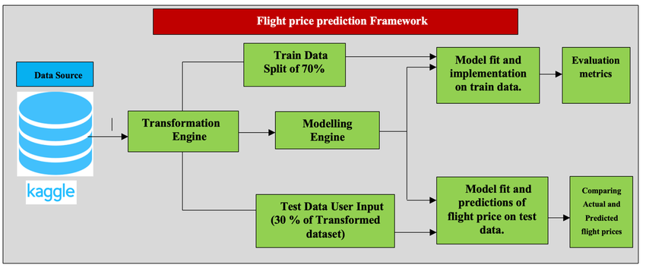
SYSTEM ARCHITECTURE

Slide 16
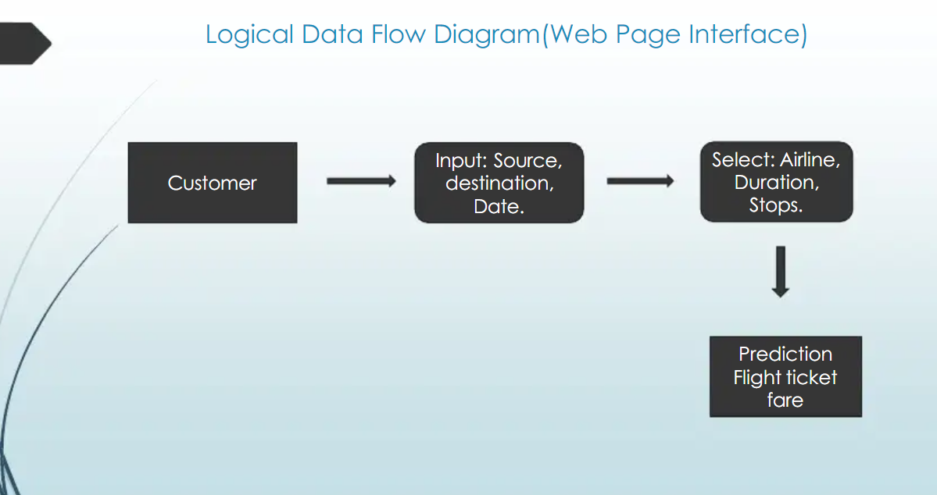
DATA FLOW DIAGRAM

Slide 17
CONCLUSION
Flight prices almost always remain constant or increase between the major cities.
Tourist routes and routes that offer services involving Tier-2 cities of the country have uneven trends related to the increase and decrease of airline ticket prices.
In this system, customer can predict the flight price of a particular seat on a day before booking the flight tickets.
It will provide an ease to the customer for the flight booking. Travelers can save money if they choose to buy a ticket when it’s price is the lowest.
The problem is how to determine when is the best time to buy flight ticket for the desired destination and period.
Routes with data collected over the longer duration of time tend to facilitate with much more accurate predictions in the model and thus lead to higher average savings

Slide 18

FUTURE ENHANCEMENT
More routes can be added and the same analysis can be expanded to major airports and travel routes across the Globe.
The analysis can be done by increasing the data points and increasing the historical data used. That will train the model better giving better accuracies and more savings.
More rules can be added in the Rule based learning based on our understanding of the industry, also incorporating the offer periods given by the airlines.
Developing a more user friendly interface for various routes giving more flexibility to the users.

Slide 19
THANK YOU

